Slide 1

Programming One (csc7050)
Aidan McGowan
Methods with parameter passing

Slide 2

Parameter passing

Slide 3
Declaring a method with a parameter
In a car analogy, pressing a car’s accelerator pedal sends a message to the car to perform a task—to go faster. But how fast should the car accelerate?
The farther down you press the pedal, the faster the car accelerates.
So the message to the car actually includes the task to perform and additional information that helps the car perform the task. This additional information is known as a parameter.

Slide 4
Declaring a method with a parameter
Similarly, a method can require one or more parameters that represent additional information it needs to perform its task.
Parameters are defined in a comma-separated parameter list, which is located inside the parentheses that follow the method name.
Each parameter must specify a type and a variable name. The parameter list may contain any number of parameters, including none at all.
Empty parentheses following the method name indicate that a method does not require any parameters.

Slide 5
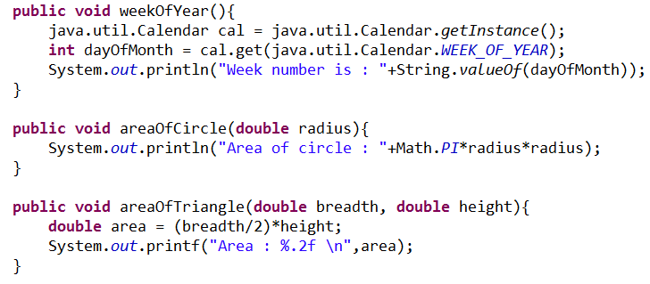
Declaring a method with a parameter
Method with no parameters
Method with one parameter – a double (referred to as radius throughout the method)
Method with two parameters

Slide 6
Arguments to a Method
A method call supplies values—called arguments—for each of the method’s parameters.
For example, the method System.out.println requires an argument that specifies the data to output in a command window.
e.g. System.out.println(“Hello world”);
Similarly, to make a deposit into a bank account, a deposit method specifies a parameter that represents the deposit amount. When the deposit method is called, an argument value representing the deposit amount is assigned to the method’s parameter. The method then makes a deposit of that amount.

Slide 7
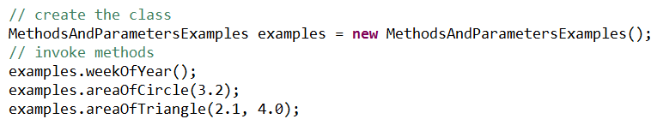

Arguments to a Method
For Instance methods (methods that are not marked as static), firstly create the class and then invoke with the correct arguments (correctly ordered datatypes)

Slide 8
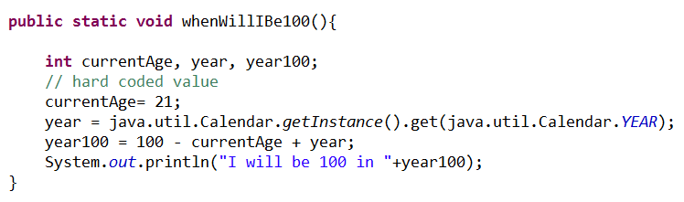
Recall the age method ..
This would be much more useful if it were parameterised !

Slide 9
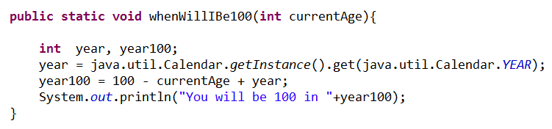

Recall the age method ..
That’s better
Now takes an int as a parameter argument

Slide 10
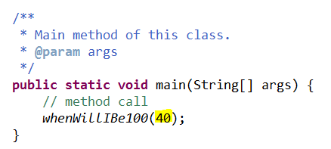
Invoking a method with an argument

Slide 11
Method exercise I – with arguments
Create a method that will print to screen your name a number of times. The number of times will be determined by the value passed as a parameter.
Notes:
public static void outputName(int times){
for (int loop=1; loop<=times; loop++){
System.out.println("Aidan");
}
}

Slide 12
Method exercise II – with arguments
Create a method that starts a countdown, ending at zero. 10, 9, 8 etc…
The start value of the countdown should be passed as a parameter. (Use a FOR loop for the countdown).
Notes:
public static void count(int start){
for (int loop=start; loop>=0; loop--){
System.out.println(loop);
}
}

Slide 13
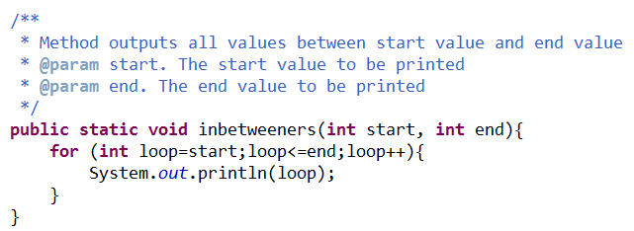
More than one parameter ?
Actually it’s unlimited .. but don’t use too many ! Keep your code readable.

Slide 14
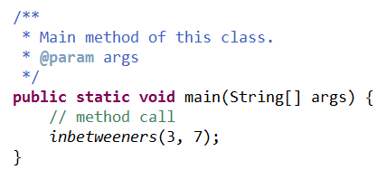
More than one parameter ..
Invoking a method with parameters

Slide 15
Parameterised method - exercise
Create a method (called min) that takes two arguments (of type int) and outputs (to screen) the min value..
Notes:
public static void min(int num1, int num2){
if (num1>num2){
System.out.printf("%d is bigger than %d",num1, num2);
} else if (num2>num1){
System.out.printf("%d is bigger than %d",num2, num1);
} else {
System.out.printf("%d is same as %d",num1, num2);
}
}

